Slide 1

The Quantum Bank
Zhong Chen, Titiksha Ghosh, Norwu Ramatu Kemokai, Xuejia Li, Lystra Injamuri Naveen
PJM 5900 Group 2
Prof. Cheryl Gross

Slide 2

Project Sponsor Organization Background
Quantum Bank Inc. operates as a regional bank with branches situated across the southeastern region.
In 2006, the bank’s application achieved tremendous success, but faced competition from both traditional and non-traditional organizations.
The bank’s goal is to provide customers with an app that incorporates the most up-to-date features.
The bank aims to expand its reach beyond its current geographic.
Stacey Thomas was the Vice President of Information Systems and was charge of overseeing the project.
Notes:
To begin with, I would like to give you some information about the project sponsor organization background. Quantum Bank Inc. is a regional bank with many locations throughout the Southeast. The bank's application was tremendously successful in 2006, but it was up against stiff competition from both traditional and non-traditional enterprises. The bank's objective is to give consumers with an app that has the most recent features, guaranteeing that they have access to the most recent financial services. Quantum Bank aspires to go beyond its existing geographic boundaries and become a household name across the country. To enhance customer services, Quantum Bank launched a mobile app by allowing users to check account balances, receive information about the bank's many services, and obtain email inquiries and contact information. The app also contains links to a number of other relevant information sources. Despite competition from both traditional and non-traditional sources, the app was a big hit. Quantum Bank opted to improve the app with additional features to make banking even more accessible as part of its strategic aim to expand its reach outside the southeastern area. Otherwise, Stacey Thomas was the Vice President of Information Systems and was in charge of overseeing the project.

Slide 3

Project Background
This project will help Quantum’s bank successfully upgrade their mobile app.
The vice president of information system Stacey Thomas made the decision to staff the project Manager from the internal team because of the strategic importance of the project.
The Latest features of the app was proposed to include features such as mobile bill payment, allowing customers to apply for credit cards and loans be able to virtually open accounts and manage their investment portfolios at their own convenience
Stacey Thomas Shortlisted two Candidates For the project manager position, Bill Fence and Andy Dover
Bill was responsible for programming on the Previous app and he proposed alternative ways for incorporating importance features in the app
Andy Dover Worked on several improve project, he have good communication skills and was considered highly competent in completing task.
Notes:
Next. I’d like to talk about the project background. The project's goal is to assist Quantum Bank in effectively upgrading its mobile application. As we all know, mobile applications have become a significant tool for banks in providing easy and efficient financial services to its consumers. Quantum Bank chose to improve its mobile application in response to this trend in order to give consumers with more advanced capabilities. Stacey Thomas, Vice President of Information Systems, took the strategic choice to employ an internal project manager to assure the project's success. This means that we have a team of professionals that are familiar with the bank's existing systems and procedures and are ideally suited to manage projects from beginning to end.Among the new features of the mobile app will be mobile bill payment, the ability for clients to apply for credit cards and loans, the ability to establish accounts electronically, and the ability to monitor their portfolios at their leisure. Next, I will hand in over to Lystra, she will give us some information about the Benefits to Sponsor Organization.

Slide 4

Benefits to Sponsor Organization
This can include the organization that initiated the project, a funding agency, a stakeholder group, or any other party that has a direct or indirect interest in the project's success or failure. The benefits of a sponsor organization for a case study could include:
Gaining insights into the effectiveness of their project management approach, Identifying areas for improvement, and validating the success of the project.
Additionally, a sponsor organization may use case studies as a marketing tool to showcase their successes to potential clients or investors.
Notes:
I would like to give some information regarding about benefits to sponsor organization. The sponsor organization refers to the entity that initiated the project or has a vested interest in its outcome, such as a funding agency or stakeholder group. By commissioning a case study, the sponsor organization can gain valuable insights into their project management strategies, pinpoint areas for improvement, and validate the project's success. Furthermore, a case study can serve as a marketing tool for the sponsor organization to showcase their accomplishments to potential investors or clients.

Slide 5

Project Objectives
To enhance Quantum Bank's mobile app to include a mobile bill payment service, credit card and loan application, account opening, and investment portfolio management.
To select a project manager for the mobile app enhancement project.
To complete the project on time and on budget, considering the changes in the scope of the project that were made as the project progressed.
To consider suggestions for extending the app's functionality as updates after the app is officially launched.
To maintain the bank's website, staying involved with all technical aspects of the site, and developing an excellent rapport with direct reports.
To ensure that the project is staffed internally, as opposed to employing the services of consulting firms.
To compete with traditional and nontraditional organizations and expand the bank's presence beyond its current geographical area.
To incorporate key features into the app, and propose alternative ways for incorporating key features, considering the interrelated issues.
Notes:
Quantum Bank aims to improve its mobile app by adding a mobile bill payment service, credit card and loan application, account opening, and investment portfolio management features. The bank is looking for a project manager to lead this project, which must be completed within the set timeframe and budget. Suggestions for extending the app's functionality may be considered after the app is launched. The project manager will also be responsible for maintaining the bank's website, ensuring that it runs smoothly and that their team is working efficiently. The project team will be composed of internal staff, and the bank's goal is to expand its presence beyond its current geographic area by competing with both traditional and nontraditional organizations. The project manager will need to identify key features to incorporate into the app and propose alternative solutions to address related issues.
Quantum Bank has set a goal to enhance its mobile app by introducing new features such as mobile bill payment, credit card and loan application, account opening, and investment portfolio management. The bank is seeking a qualified project manager who can lead this project and ensure that it is completed on time and within budget. Suggestions for adding new functionalities may be considered later. Additionally, the project manager will oversee the bank's website and build a positive relationship with their team. The project team will consist of internal staff, and the bank plans to expand its market reach beyond its current area by competing with both traditional and nontraditional players. The project manager will need to identify key features for the app and suggest alternative approaches that address interconnected challenges.
The goal of Quantum Bank is to enhance its mobile app by adding several features, such as mobile bill payment, credit card and loan application, account opening, and investment portfolio management. The bank needs a project manager who can deliver the project on time and on budget, while taking into account the project's changing scope. Additionally, the bank welcomes suggestions for extending the app's functionality after its official launch. The project manager will also be responsible for overseeing the bank's website, ensuring that it operates efficiently, and building strong relationships with direct reports. The bank prefers to staff the project internally and aims to compete with both traditional and nontraditional institutions, expanding its presence beyond its current geographic area. The project manager will have to identify key features for the app and explore alternative solutions that address interrelated issues. Next I will hand in over to Titiksha, She will give some information about project life cycle phases.

Slide 6
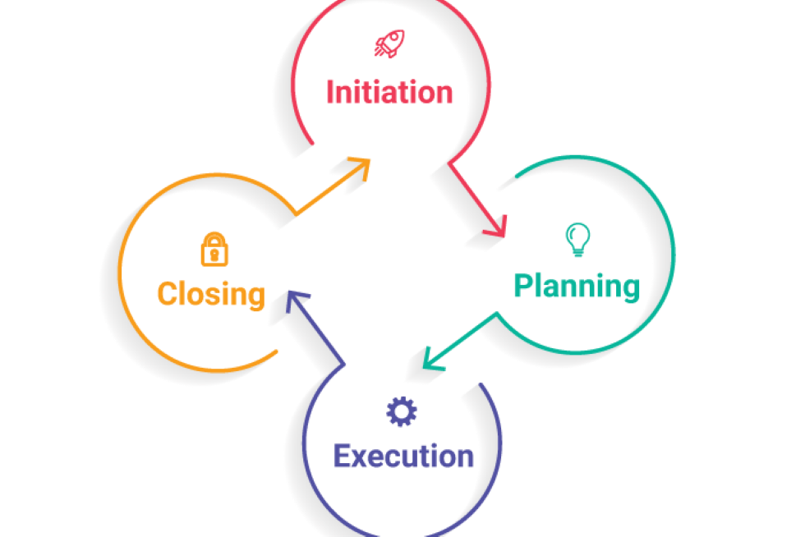
Project Life Cycle Phases
Life cycle phases could be delineated as stages of a project that goes through from its initiation to its enclosure. These stages are crucial in ensuring effective project management and control throughout the project duration. The phases includes:
Initiation
Planning
Execution
Monitoring and Controlling
Closing

Slide 7
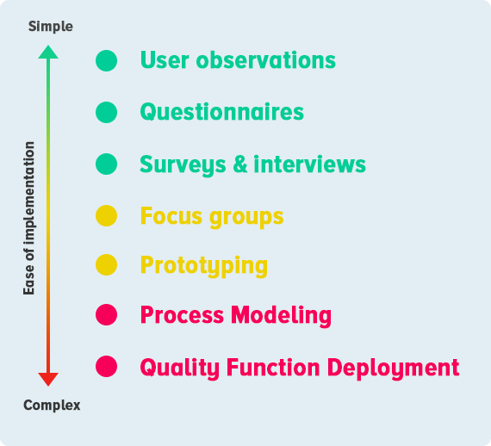
Major Deliverables
The key outcomes or results that a project is expected to produce, which can be either tangible or intangible, are known as the major deliverables of the project. These deliverables are the specific objectives or targets that the project is designed to achieve or deliver.
Project plan
Requirement document
Design documents
Testing and quality assurance documents
Training and user manual
Final product or service
Project closure report

Slide 8
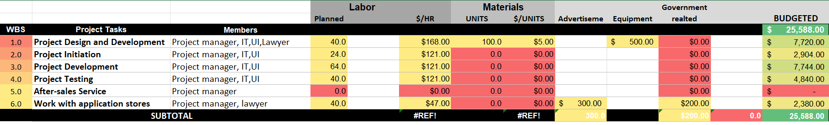
Summary Budget
Notes:
based on project manager is full time employee in the bank, and IT technicians and UI design department are part time employee, lawyer is part time
Project managers: 6931/ month in Boston
IT technician: 35/hour in Boston
UI interface designer salary: 86/hour
Lawyer: 47/hour

Slide 9

Summary Schedule
1 May. – 5 May 2023
1）Project design and development. （Date: 05/01/2023-05/05/2023 9am-5pm 40h )
08 May. – 5 May. 2023
2 ）Project initiation. (Date: 05/08/2023-05/10/2023 24h)
10 May – 19 May 2023
3 ）Project development. (05/10/2023-05/19/2023 64h)
22–26 May 2023
4 ）Project testing. (05/22/2023-05/26/2023 40h)
29 May 2023
5 ）After-sales service.(Date: After 05/29/2023)
29–6 May 2023
6 ）Cooperation with Application stores.(05/29/2023-06/05/2023 40h)
Notes:
1）Project design and development, IT front-end and back-end developers to discuss the feasibility of the program, the difficulty, the time and cost required
UI department for product interface design, color visual design, icon design, layout design （ Date: 05/01/2023-05/05/2023 9am-5pm 40h )
2 ）Project initiation: evaluate the development cycle and set the release time point. (Date: 05/08/2023-05/10/2023 24h)
3 ）Project development: front-end development, program development, interface docking, third-party access, regular project meetings. (Date: 05/10/2023-05/19/2023 64h)
4 ）Project testing: app content testing, performance testing, functional testing, visual testing, debugging and repair, acceptance. (05/22/2023-05/26/2023 40h)
5 ）After-sales service: follow-up technical maintenance, continuous follow-up, project operation support. (Date: After 05/29/2023)
6 ）Cooperation with Application stores, on-line process. (05/29/2023-06/05/2023 40h), need to submit various documents, business license, comply with relevant regulations.

Slide 10

Acceptance Criteria
Access the app from all app stores and open account using “ Open a new Account” Service
User can pay their mobile bills by using the “ mobile bill payment “ Service. User can add and see details of their regular payments also delete details of regular payments
To apply for credit cards and loan use the “Apply for credit card” or the “Apply for loan “ service
Easily manage Investment Portfolios

Slide 11
References
How to make a complete APP. https://www.apicloud.com/blogDetails/7195
IT support salary in Boston, MA. https://www.indeed.com/career/it-support/salaries/Boston--MA?from=top_sb
Lawyer salary in Boston, MA. https://www.indeed.com/career/lawyer/salaries/Boston--MA
Project manager salary in Boston, MA. https://www.indeed.com/career/project-manager/salaries/Boston--MA
MacNeil, C. (2022). How to create and stick with a project budget. ASANA. https://asana.com/resources/project-budget
Meredith, J. & Shafer, S. (2021). Project management in practice. Wiley.
User interface designer salary in Boston, MA. https://www.indeed.com/career/user-interface-designer/salaries/Boston--MA

